Slide 1

Plants
A web shop for plants

Slide 2
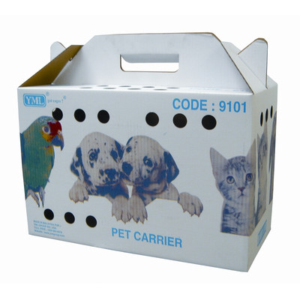


Tapping into new markets
Goal: Not just another web shop…
There are not too many web shops that sell living things – which got us thinking:
Web show idea #1: iAnimals (working title)
A web shop for exotic animals, which you can then choose from looking at the live webcam feeds that are installed in the cages:
Home delivered

Slide 3
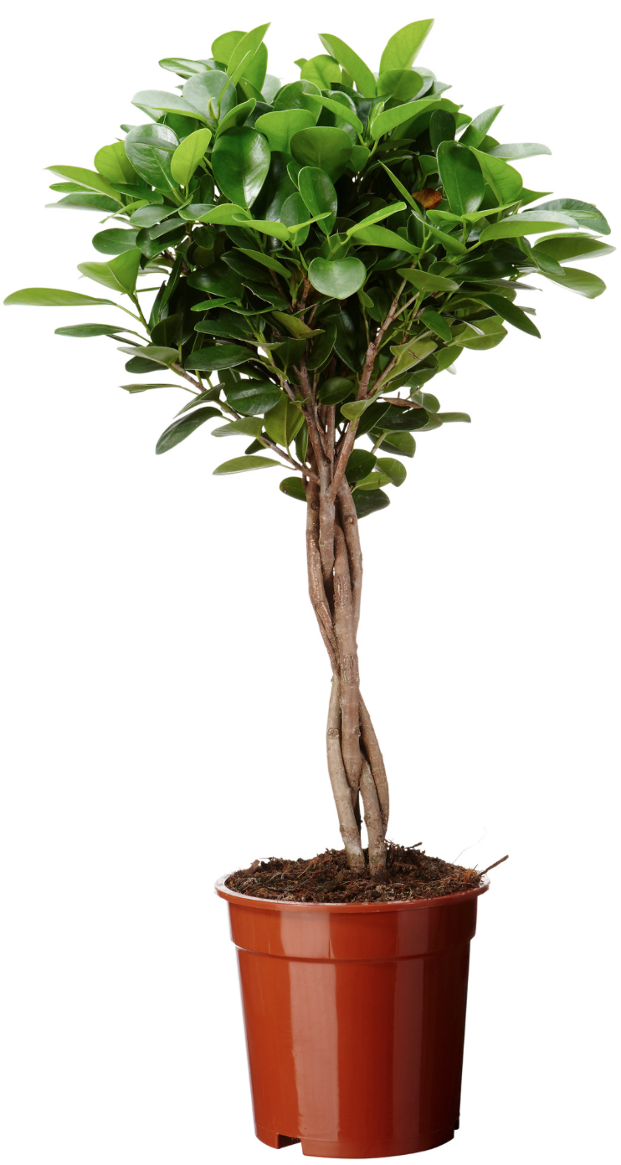
A more sensible approach
However: Storage costs are too high for animals and they can die in the distribution process…
We decided to go for a more realistic approach:
Plants are the ideal product for a web shop because (includes task 1.2)
not everyone has a car, almost nobody has the right car to transport a plant
only few people have the know-how to buy the right plant for their home

Slide 4
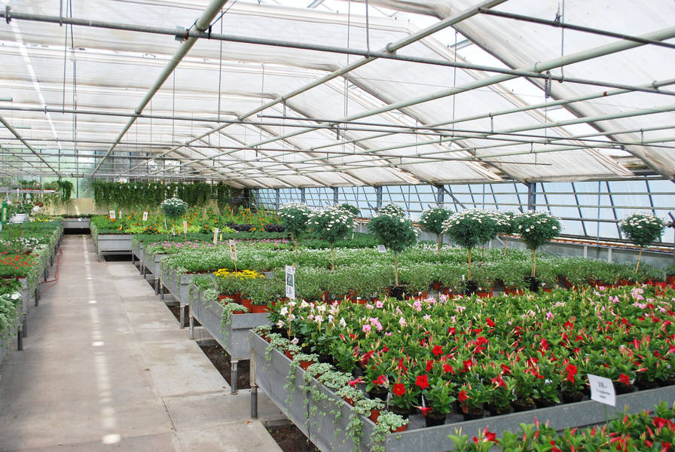
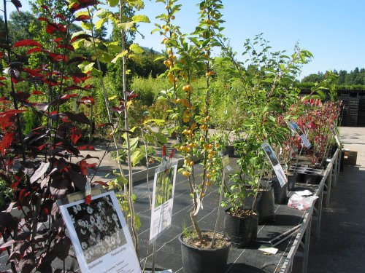
Business idea: plants
Business idea behind it (includes task 1.3)
People only have a vague idea what a plant costs, so we can optimize our margin.
and we assume that people, who buy plants online buy them just to hipster up their apartment – plants will die soon and they will order new ones
Partnership with local greenhouses is possible, so we do not even have to store the plants ourselves

Slide 5
Features of our web shop
What our web shop offers:
Navigating through the product pages (rooms) with an intuitive and appealing design
Includes tasks: 1.4 / 2.1-2.2 / 3.1-3.2 / 4.1-4.3 / 5.1-5.2 / 7.3
All sites are available in two languages, choice is stored in cookies
Includes tasks: 5.3 / 8.1
You can choose from a selection of plants and add them to your shopping cart, the shopping cart object is stored in a session
Includes tasks: 6.1 / 8.2-8.3 / 9.1
After selecting a plant, you can proceed with the checkout process, enter your address and choose shipping method
Includes tasks: 6.2-6.4 / 7.1-7.2
Every plant can have multiple characteristics (such as pouring frequency, sunlight exposure etc.) and accessories, which are all stored in a database and are accessed by web shop
Includes tasks: 9.2-9.3 / 10.1-10.3

Slide 6
Features of our web shop
Register/Login with your user credentials
Includes tasks: 1.3 / 8.3
Administrator part with workflow tool
Includes tasks: 10.4, 11.1
Search functionality, if you are looking for a specific plant
Includes tasks: 12.1
HTML template -> smarty
Includes tasks: 12.2
Regular Expressions (everywhere)
Includes tasks: 12.3
Plant wizard, who helps you choose the right plant for you
Includes tasks: 1.3
Beautiful code
Includes task: 6.5

Slide 7
Work distribution among team
Experience tier
Michael: almost no webdev experience
Basic concept of webshop
OOP PHP / Javascript / Cookies / Session
Plant wizard
Simon: little webdev experience
MySQL part (DAO)
Sign Up / Login, Order process
AJAX search
Claudio: some webdev experience
Introduce HTML templates (Smarty)
Administrator part
Mostly teaching us how to do things… (mostly code beautification)

Slide 8
Technologies used
Technologies used:
PHP / OOPHP (cookies/session)
Javascript
MySQL
AJAX
Smarty

Slide 9
Lessons learned
If we ever have a business idea and need a web shop, we will entrust the programming to an external company…
Things that we figured out
task setup needed a lot of refactoring
HTML template saves you a lot of time
evaluate usage of frameworks
session handling is NOT trivial!

Slide 10
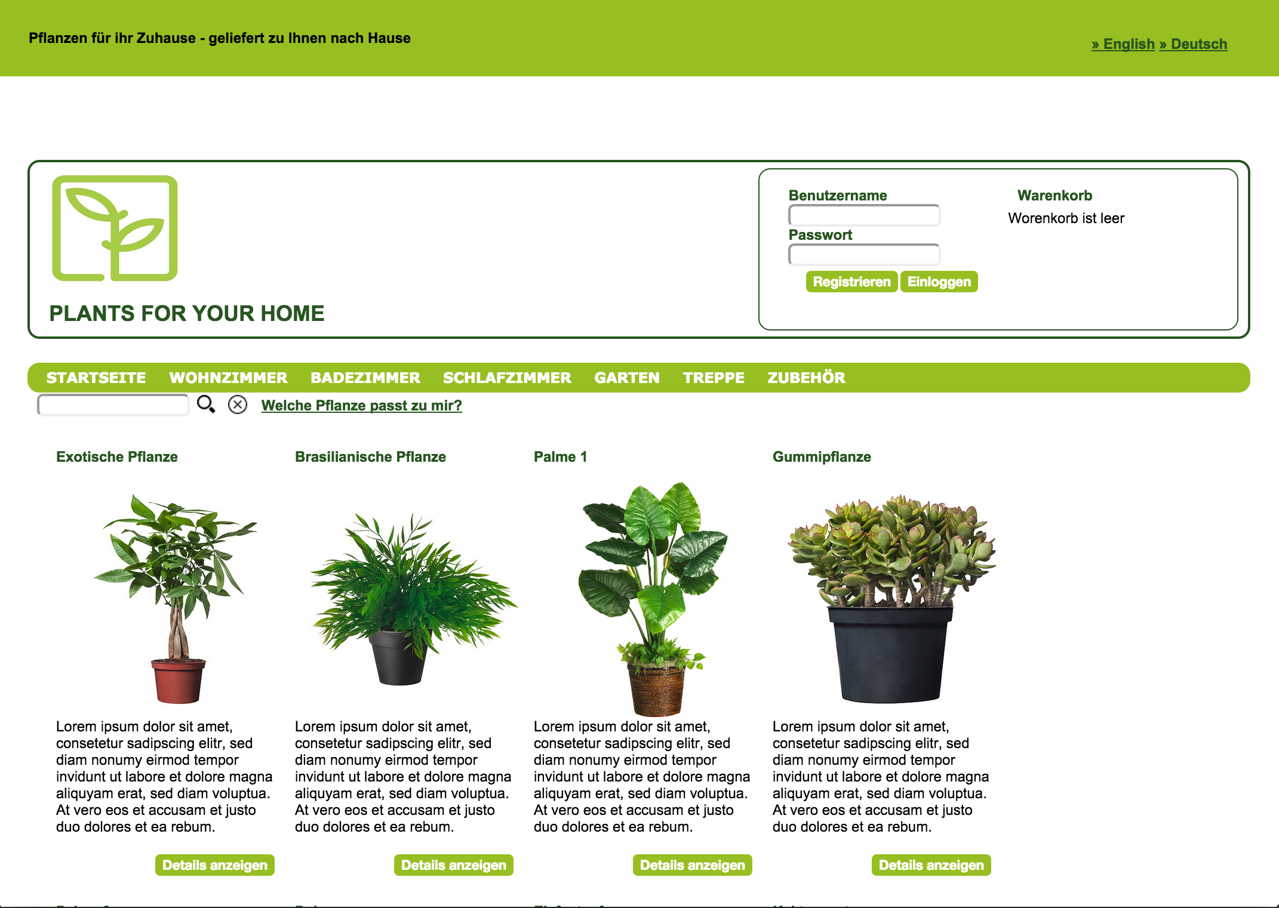
LIVE DEMO

